Slide 1
Digital Signal Processing
Project Presentation
EECE – 312
Section – A
Group – 03

Slide 2
Group Members
Lamiya Mahbub
Mehrab Ibne Masud Badhon
Muntasir Ahmed
Naimujjaman
Juthika Alamgir Orpa
Gourab Datta

Slide 3
Digital Hearing Aid Compensating for Hearing Loss of Different Level

Slide 4
Classification of Hearing Loss and Hearing Level
Normal Hearing
-10dB -26dB
01
Mild Hearing Loss
02
27dB-40dB
Moderate Hearing Loss
03
40dB-70dB
Severe hearing loss
04
70dB – 90dB
Profound Hearing loss
05
>90dB

Slide 5




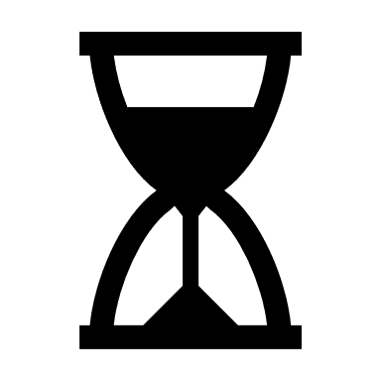
Working Principle
Microphone receives
sound and converts it
into a digital signal
01
02
Amplifier increases
the strength of the
digital signal
The speaker produces
the amplified sound
into the ear
03

Slide 6

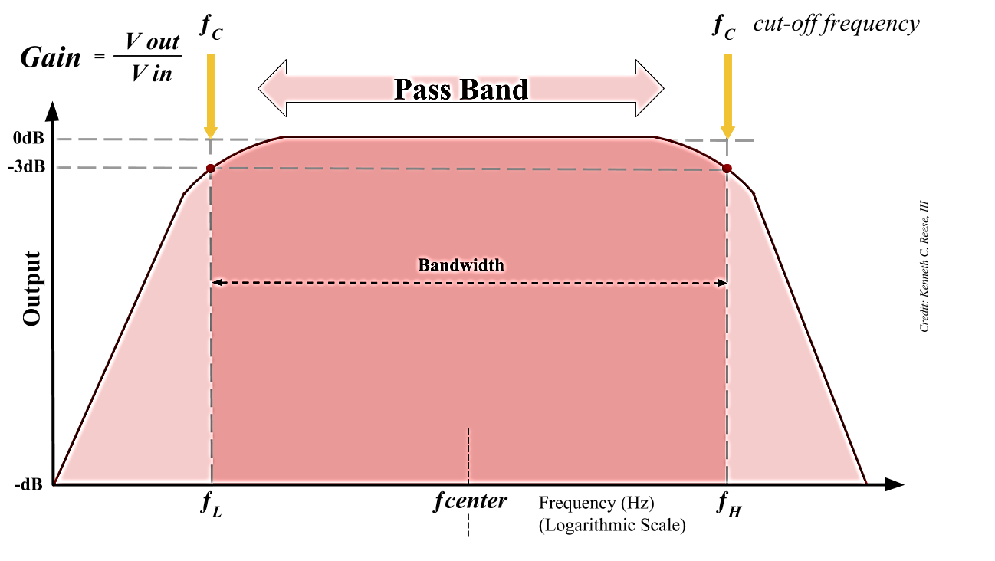
Band Pass Filter

Slide 7
Procedure
Noise Reduction Filter
Desired Signal
01
03
05
Input Signal
02
04
Noise Addition (AWGN)
Amplification According to Preference

Slide 8
Algorithm
Declare a function called 'hearing aid'
Insert A built in matlab audio named " HANDEL'
Add Awgn Noise with SNR=40 as a pretention of background noise
Denoise the signal using a low pass filter by designing using fixed parameters
denoised signal is inseted into a frequency shaper
design a Band pass filter
insert the cut off frequency of the band pass filter according to loss level
denoised signal filtered by bandpass and amplified
the filtered sound is converted to frequency domain using FFT
Spectrogram is analysed which takes into account of Amplitude, frequency and time domain
phase values are saved
magnitude shaping using threshold=1000
when amplitude shaped, saved phases are multiplied
IFFT is done on the amplitude shaped version
A time domain signal according to preference is played
spectogram of noised signal and final signal is obtained in GUI

Slide 9
Inserting Sample Audio
function hearing_aid(app,Fst1,Fp1,Fp2,Fst2,Ast1,Ap,Ast2) %code declared as function
app.StateEditField.Value=('input sound’) %shows in state when input
sound is playing
load handel.mat
fs=Fs; %imprting data got from handel.mat
y = y(:, 1); %for 1 sec
plot(app.UIAxes,y); %uiaxes shows the graph in matlab gui
app.StateEditField.Value=('playing actual sound...')
sound(y);
pause(10)

Slide 10
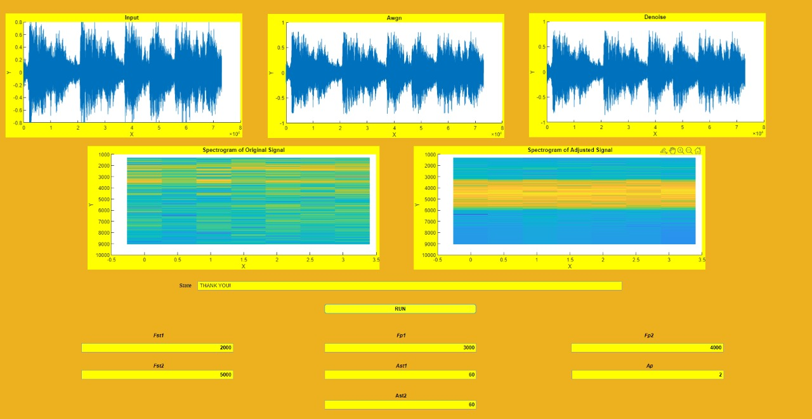
Input Signal Curve

Slide 11
Adding Noise to the Audio
y = awgn(y,40);
noi = y;
plot(app.UIAxes2,y);
app.StateEditField.Value=('playing added noise...’); %shows in state
bar in gui
sound(y); %playing the sound
pause(10) %pausing the sound in 10 sec

Slide 12
Sample Audio with Noise Curve

Slide 13
Denoising Process Using a Low Pass Filter
hlpf = fdesign.lowpass('Fp,Fst,Ap,Ast',3.0e3,3.5e3,0.5,50,fs); %designing
lowpass filter using builtin function
[ Fp= passband frequency
Fst= stopband frequency
Ap=passband ripple
Ast = stopband ripple ]
D = design(hlpf); %lowpass filter
%freqz(D); %needed if we want the spectrum of the filter
x = filter(D,y); %filtering the noised signal
app.StateEditField.Value=('playing denoised sound’); %showed in state while
playing the sound
plot(app.UIAxes3,x); %plotting in the 3rd graph in gui
sound(x,fs); %playing the denoised sound
pause(10) %pause after 10 sec

Slide 14
Denoised Audio Curve

Slide 15
Frequency Shaping Using Band Pass of
Denoised Signal
T = 1/fs; %setting time
len = length(x);
p = log2(len); %level division denoised signal
p = ceil(p); %making p an integer
N = 2^p; %number of level
f1 = fdesign.bandpass(Fst1,Fp1,Fp2,Fst2,Ast1,Ap,Ast2,5*fs);%setting
the values according to the requirement
hd = design(f1,'equiripple’); %bandpass function
y = filter(hd,x); %denoised signal filtered by bandpass
%freqz(hd); %filter frequency response if needed
y = y*100; %amplification
app.StateEditField.Value=('playing frequency shaped...');
sound(y,fs); %playing the freq shaped sound
pause(10); %pause after 10 sec

Slide 16
Amplitude Shaping of Frequency Shaped Signal
Using Threshold
app.StateEditField.Value=('amplitude shaper')
out1=fft(y);
phse=angle(out1);%saving the phase values before amp shaping
mag=abs(out1)/N;%magnitude of freq shaped signal
[magsig,~]=size(mag);
threshold=1000;
out=zeros(magsig,1);
for i=1:magsig/2
if(mag(i)>threshold)
mag(i)=threshold;mag(magsig-i)=threshold;
end
out(i)=mag(i)*exp(j*phse(i));%setting the magnitudes same as
the previous position by multiplying exp phase
out(magsig-i)=out(i);
end

Slide 17
Final Output in Time Domain Using IFFT
outfinal=real(ifft(out))*10000; %taking only real value after ifft of the
amp shaped signal
app.StateEditField.Value=('playing amplitude shaped...');
sound(outfinal,fs); %playing the finally edited sound
pause(10);%pause after 10 sec

Slide 18
Finding the Spectrum of Noisy and
Adjusted Signal
myAxe = app.UIAxes4;
[S,F,T] = spectrogram(noi);
imagesc(myAxe, F, T, log(abs(S))); %plot the log spectrum as image
(noise added signal)
myAxe1 = app.UIAxes5;
[S1,F1,T1] = spectrogram(outfinal);
imagesc(myAxe1, F1, T1, log(abs(S1))); %plot the log spectrum as image ( final signal )
app.StateEditField.Value=('Thank you');
end
end

Slide 19
Spectrogram of Noisy Signal and Adjusted Signal

Slide 20
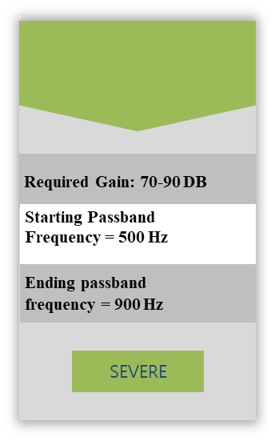
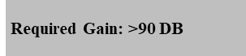
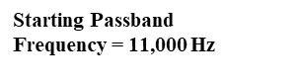
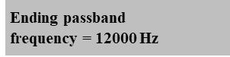

Different Scenarios
Patient No.1
Patient No.4
Patient No.3
Patient No.2
Required Gain: 27-40 DB
Required Gain: 40-70 DB
Required Gain: 70-90 DB
Starting Passband Frequency = 2000 Hz
Starting Passband Frequency = 3000 Hz
Starting Passband Frequency = 500 Hz
Ending passband frequency = 5000 Hz
Ending passband frequency = 6000 Hz
Ending passband frequency = 12000 Hz
mild
moderate
severe

Slide 21
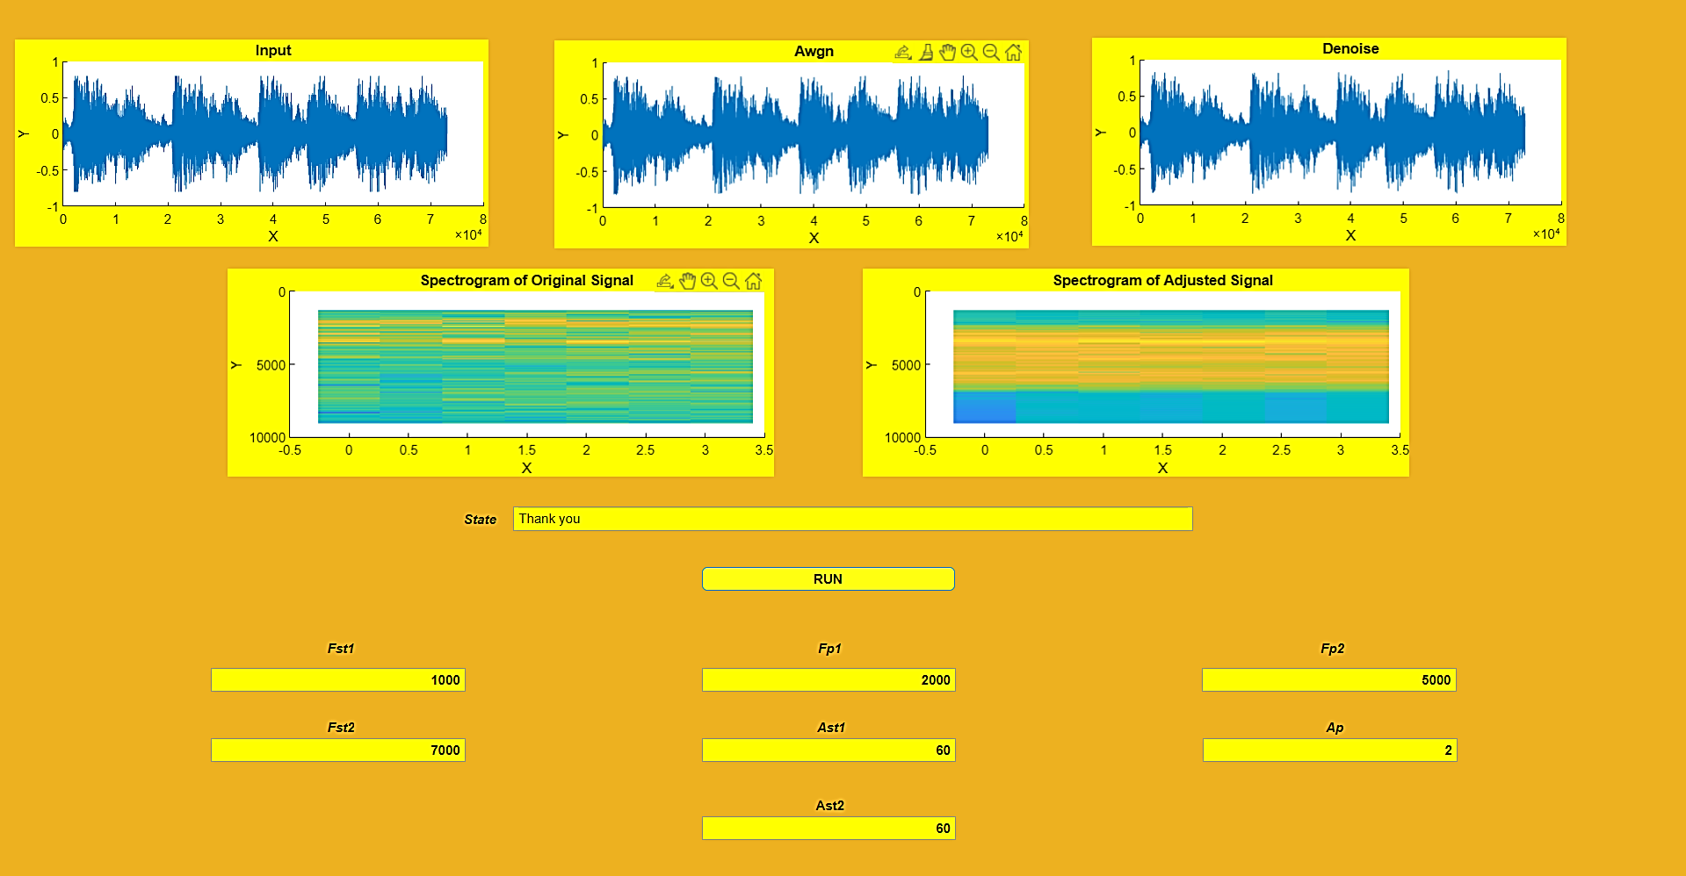
Patient No. 1: Mild Hearing Loss

Slide 22
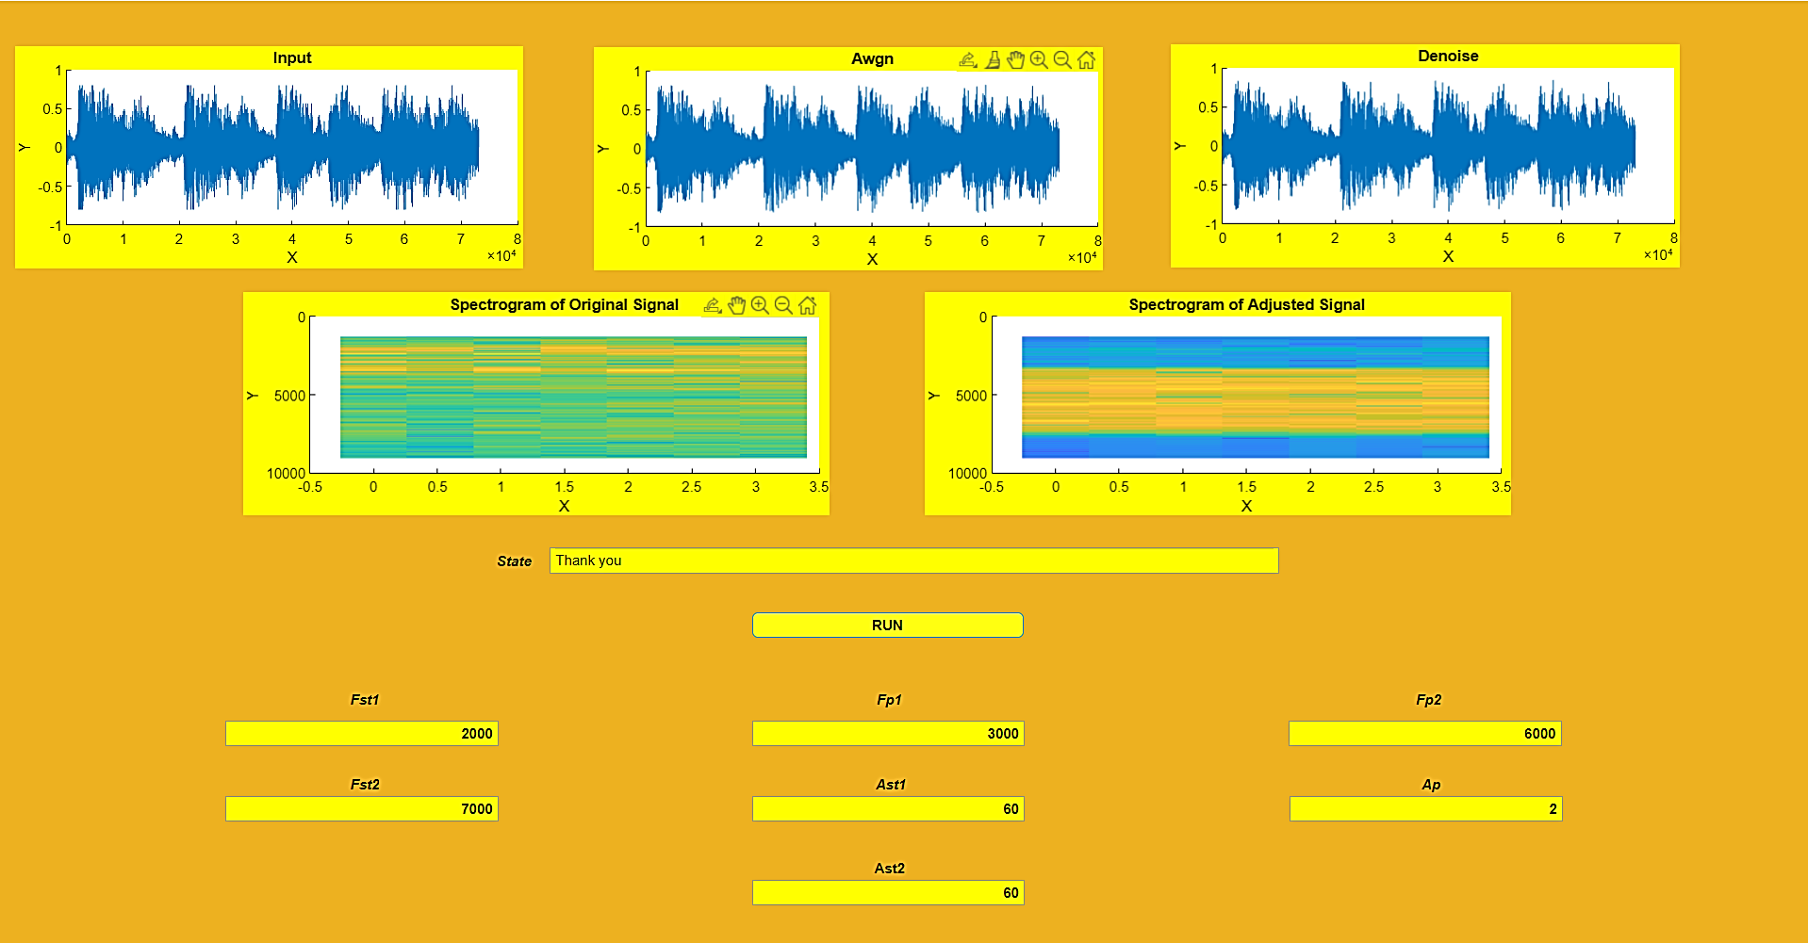
Patient No. 2: Moderate Hearing Loss

Slide 23
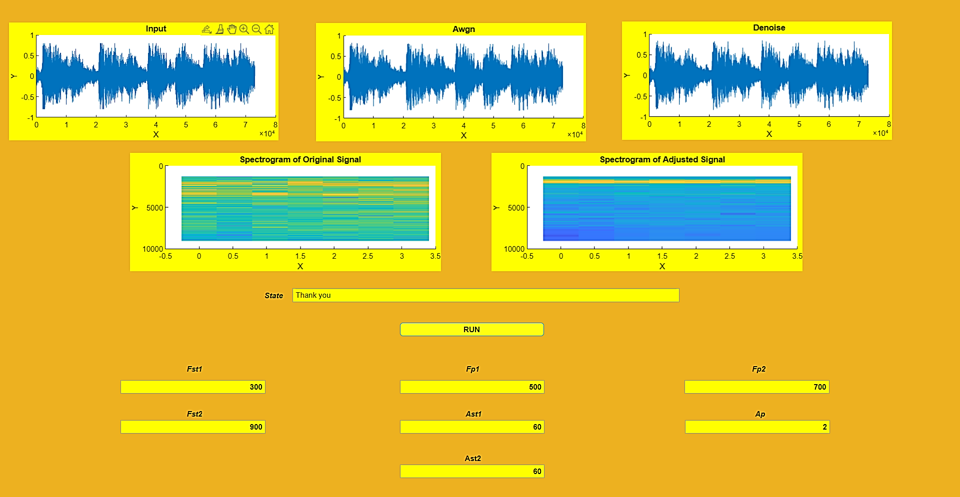
Patient No. 3: Severe Hearing Loss

Slide 24
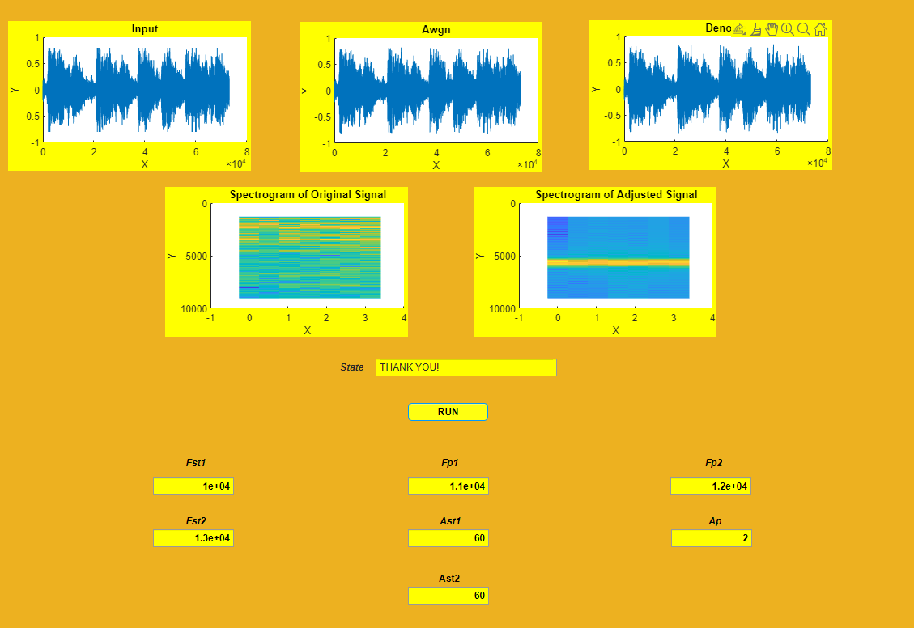
Patient No. 4: Profound Hearing Loss

Slide 25



APPLICATIONS
02
03
01
Decrease the risk of further
Hearing loss
Restores sound perception
to natural levels.
Can be connected to other devices

Slide 26
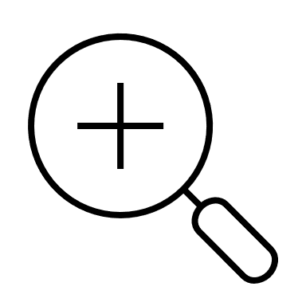


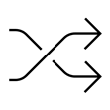

Scope for Improvement
Applying machine learning or deep learning the accuracy can me improved much further
Algorithm can be further improved in the threshold region to decrease or
increase the level of hearing.
Dynamic SQNR may be added to deal with crowded place
User level sound volume input

Slide 27
CONCLUSION
01
Implementation of Fast Fourier Transform gave
Special access to modifying the frequency and amplitude and opened up the gates for further dynamic adjustment and digitalization
signal is more suitable for hearing
impaired
people with less complexity
and more flexibility.
02

Slide 28
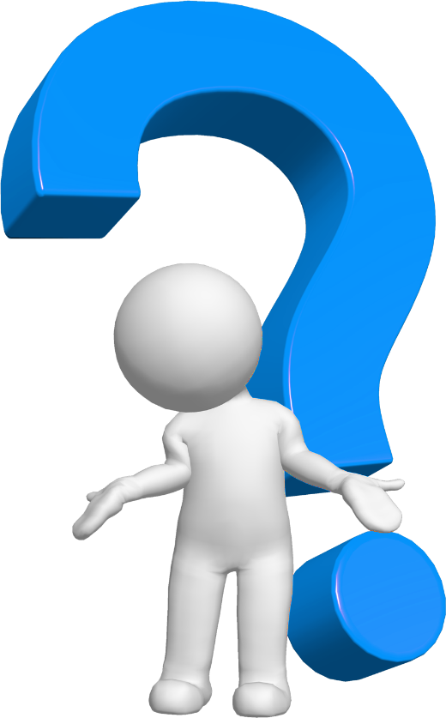
ANY
QUESTIONS?

Slide 29
X=‘Thank You’
DISP(X)

